Slide 1


Slide 2
TITLE 40pt, ALL CAPS
AGENDA 24pt, ALL CAPS

Slide 3

TITLE 40pt, ALL CAPS
SUBTITLE 24pt, ALL CAPS

Slide 4
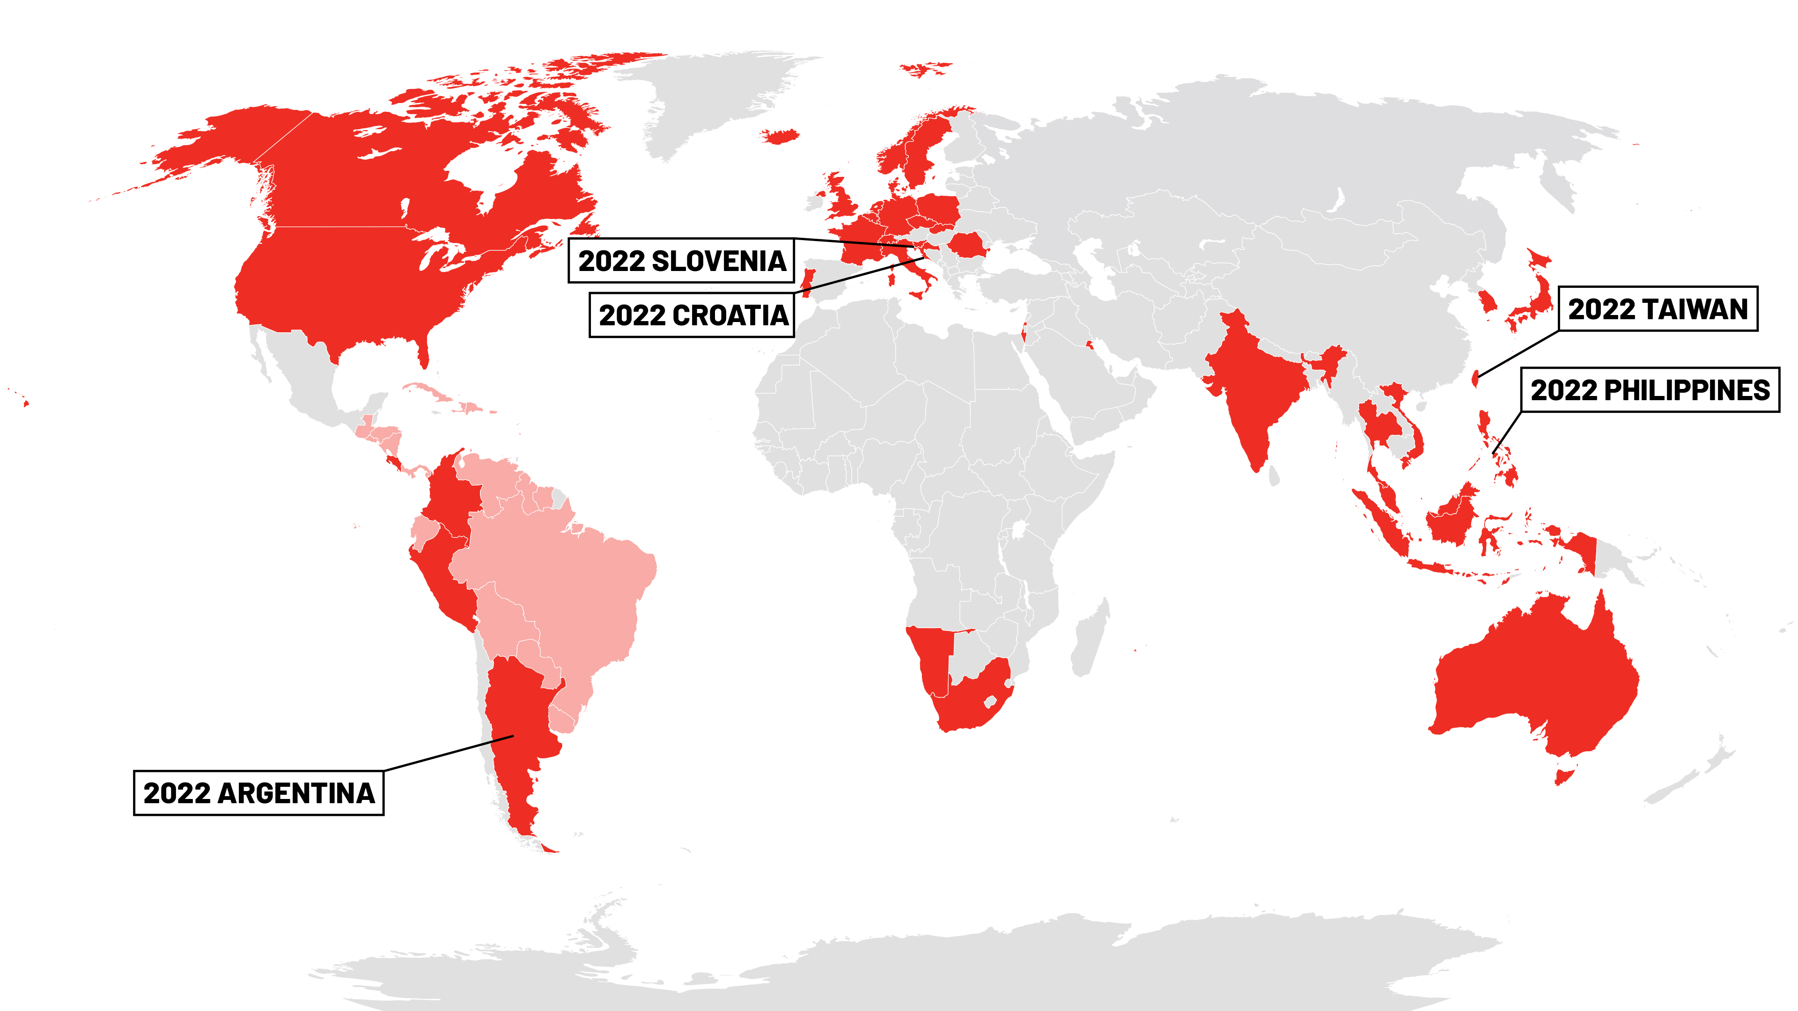

Slide 5
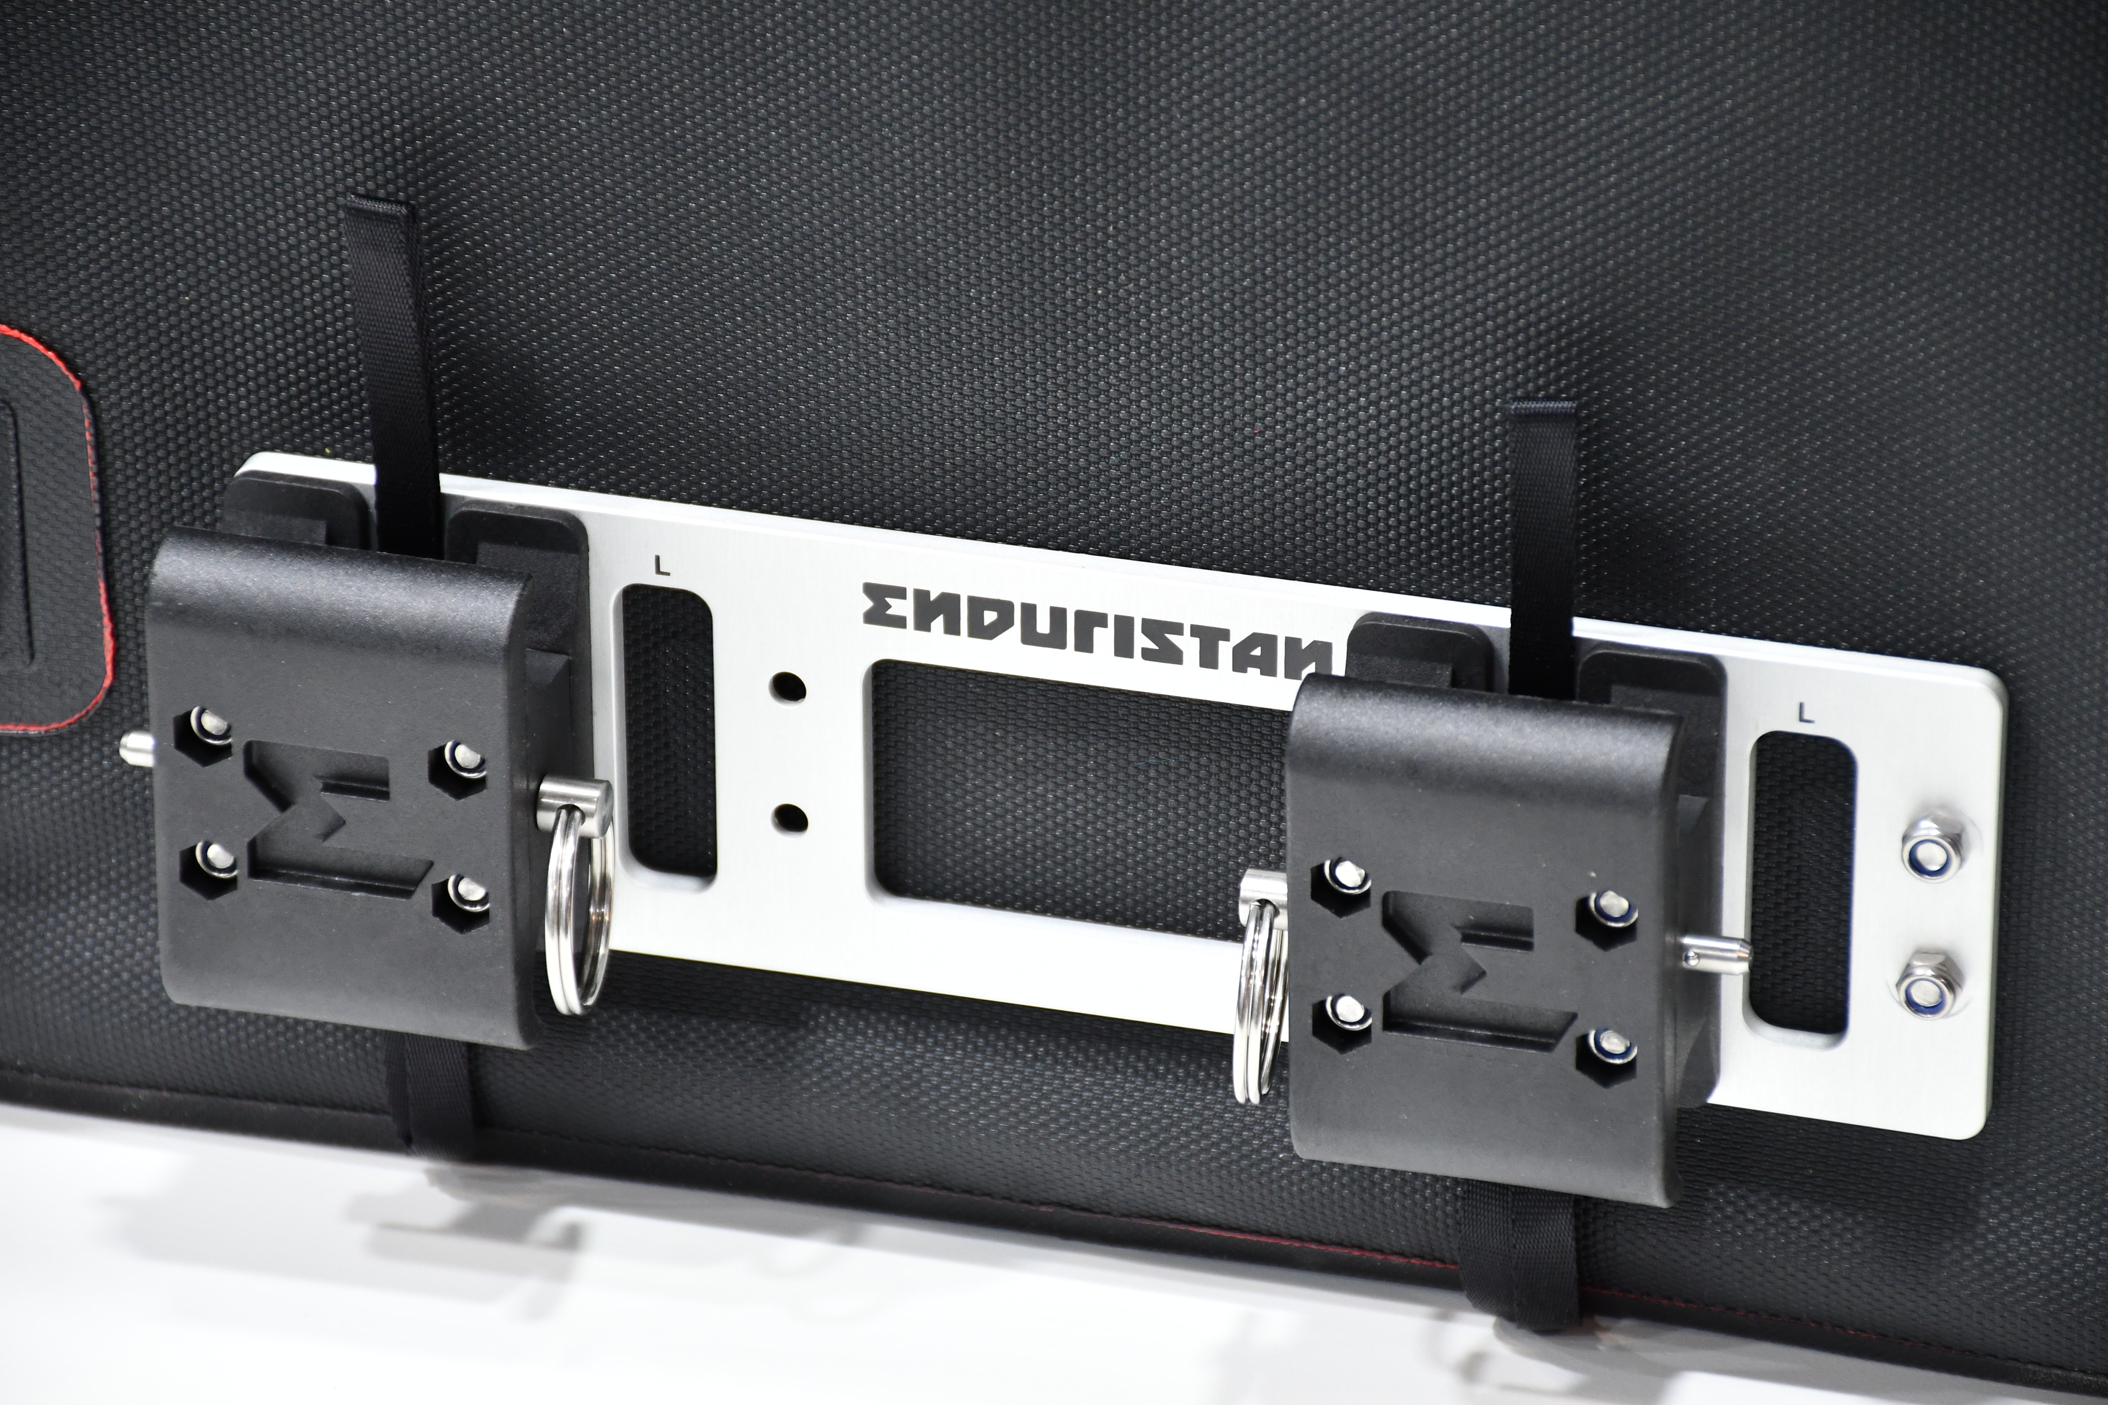
TITLE 40pt, ALL CAPS
SUBTITLE 24pt, ALL CAPS
List 24pt
BILD

Slide 6


